Slide 1



SMART INDIA HACKATHON 2026
TITLE PAGE
  Problem Statement ID – SIH26097
  Theme- Agriculture, FoodTech & Rural Development
  PS Category- Software
  Team ID- 140037
  Team Name (Registered on portal)- Hackspire 2..0
Problem Statement Title- AI-Driven voice Assistant for livelihood Mapping and NSQF-Aligned Skilling Recommendations for SC Communities under GIA component of PM-AJAY

Slide 2
IDEA TITLE
Hackspire2..0
PROPOSED SOLUTION
User Arrives at SAHAYAK
(Website or WhatsApp)
SAHAYAK is a multilingual, voice-first AI assistant that understands the livelihood profiles of SC beneficiaries and maps them to NSQF-aligned skill development pathways and relevant, ongoing government schemes such as PM-AJAY, through Website and WhatsApp.
Authentication & Security
Consent Capture · Profile Setup · Session & Audit Log
FEATURES
Voice-First, Empathetic Interviews
Beneficiary
GIA Official
Skill Partner
Administrator
Regional-language conversation, no text forms. same flow now runs on both Website and WhatsApp.
Live Government Scheme Layer
Register / Login
(Voice or WhatsApp)
Login to Admin
Dashboard
Receive Matched
Beneficiary List
Manage Scheme
Sync Sources
Scheduled scraper & cache ensure that data on MyScheme.gov.in and PM-AJAY remain up-to-date; graceful fallback in case any source fails.
2
Conversational
Profile Interview
Review Beneficiary
Matches
Confirm Seat
Availability
User & Access
Management
Real Matching Engine
Scoring using keyword weights, developed and validated locally – ranks NSQF occupations and skillsets with a confidence level.
Dual-Channel: Website & WhatsApp
View Matched Trades
& Live Schemes
Monitor KPIs &
Drop-out Risk
Update Training
Status
Audit Logs &
Compliance
One common backend supporting both website and WhatsApp users.
GIA Admin Dashboard
Live stats, channel split and beneficiary tracking pulled straight from the database.
Track Application
& Training Status
Approve / Escalate
Cases
Report Placement
Outcome
System Health
Monitoring
Grievance Support
Enables beneficiaries to raise and track complaints related to caste-based discrimination through a simple, accessible interface.
Continue as Beneficiary
Continue as GIA Official
Continue as Skill Partner
Continue as Administrator
Explainable Semantic Matching Engine
AI Voice Cloning, Voice Deepfake Detection, Synthetic Speech Detection, Real-Time Voice Authentication, Impersonation Attack Prevention, Voice Biometrics, Speaker Verification, Neural Text-to-Speech Detection, Acoustic Artifact Analysis, Spectral Analysis, Digital Signal Processing, Prosody Analysis, Deep Learning, Voice Fraud Detection, Social Engineering Prevention, Telecom Security, VoIP Security, Call Fraud Prevention, Risk Scoring Engine, Multilingual Speech Recognition, Indian Language NLP, Banking Fraud Prevention, Cybersecurity, Explainable AI, Edge AI, On-Device Inference, Privacy-Preserving AI, Real-Time Threat Detection, Financial Fraud Prevention, Speech Signal Processing
Maps dialect/synonym terms to NSQF trades & schemes via concept-expansion, explaining every match in plain language.
Sample match : input “darzi” → matched to Tailoring & Fashion Design (92%)
Why: ‘darzi’ maps to the Tailoring concept cluster; 3 active schemes found in your district.
Core Keywords
Artificial Intelligence (AI)
Machine Learning (ML)
Voice Assistant
Multilingual AI
Conversational AI
Natural Language Processing (NLP)
Speech-to-Text (STT)
Text-to-Speech (TTS)
Regional Languages & Dialects
Voice-Based Interface
Livelihood Mapping
Skill Assessment
Skill Gap Analysis
NSQF-Aligned Skilling
Skill Recommendation
Career Guidance
Employment Recommendation
Enterprise Recommendation
Job Matching
Beneficiary Profiling
Personalized Recommendations
Rural Development
SC Community Empowerment
PM-AJAY
Digital Inclusion
Low-Literacy Accessibility
IVR Integration
WhatsApp Voice Interface
Low-Connectivity Support
Local Market Analysis
Local Employment Opportunities
Self-Employment
Wage Employment
Skill Development
Rural Entrepreneurship
Data Analytics
Recommendation Engine
Cloud Computing
AI/ML-Based Profiling
Geolocation-Based Opportunities
2
Notes:
2

Slide 3








































TECHNICAL APPROACH
Hackspire2..0
TECH STACK
Web Browser / WhatsApp
Frontend: HTML, CSS, JavaScript, React.js
Backend: Node.js and Express.js
WhatsApp: Twilio, WhatsApp API , N8N
Voice & Languages: Bhashini , Whisper (ASR), Regional TTS
AI Matching: Custom NSQF & Scheme Matching Engine
Live Scheme Data: MyScheme.com, PM-AJAY Sync APIs / Scraper
Database: PostgreSQL & Redis
Security: JWT, AES-256, DPDP-compliant Consent Management
Cloud & Deploy: AWS / MeghRaj, Docker
Admin Dashboard: React.js & Chart.js
Login
Frontend
HTML5
CSS3
JavaScript
React.js
WhatsApp UI
Request
Response
Backend
Core Modules
Data Layer
API Gateway
(Node.js + Express)
Voice / ASR
Matching
Engine
Scheme
Sync
WhatsApp
Bot
SQLite
PostgreSQL
Cloud Object
Storage
Integration:
Security:
Twilio
WhatsApp API
MyScheme.gov.in
+ PM-AJAY
Whisper /
Bhashini ASR
DigiLocker
Verification
JSON Web
Tokens
AES-256
Encryption
DPDP Act
Consent
Audit /
Consent Log
Core Keywords
Artificial Intelligence (AI)
Machine Learning (ML)
Voice Assistant
Multilingual AI
Conversational AI
Natural Language Processing (NLP)
Speech-to-Text (STT)
Text-to-Speech (TTS)
Regional Languages & Dialects
Voice-Based Interface
Livelihood Mapping
Skill Assessment
Skill Gap Analysis
NSQF-Aligned Skilling
Skill Recommendation
Career Guidance
Employment Recommendation
Enterprise Recommendation
Job Matching
Beneficiary Profiling
Personalized Recommendations
Rural Development
SC Community Empowerment
PM-AJAY
Digital Inclusion
Low-Literacy Accessibility
IVR Integration
WhatsApp Voice Interface
Low-Connectivity Support
Local Market Analysis
Local Employment Opportunities
Self-Employment
Wage Employment
Skill Development
Rural Entrepreneurship
Data Analytics
Recommendation Engine
Cloud Computing
AI/ML-Based Profiling
Geolocation-Based Opportunities
Live Prototype Link : click here
Youtube Link : click here
3
Notes:
3

Slide 4
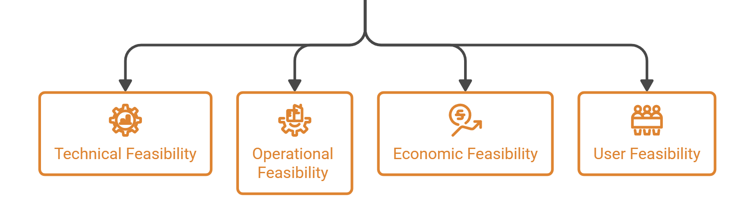
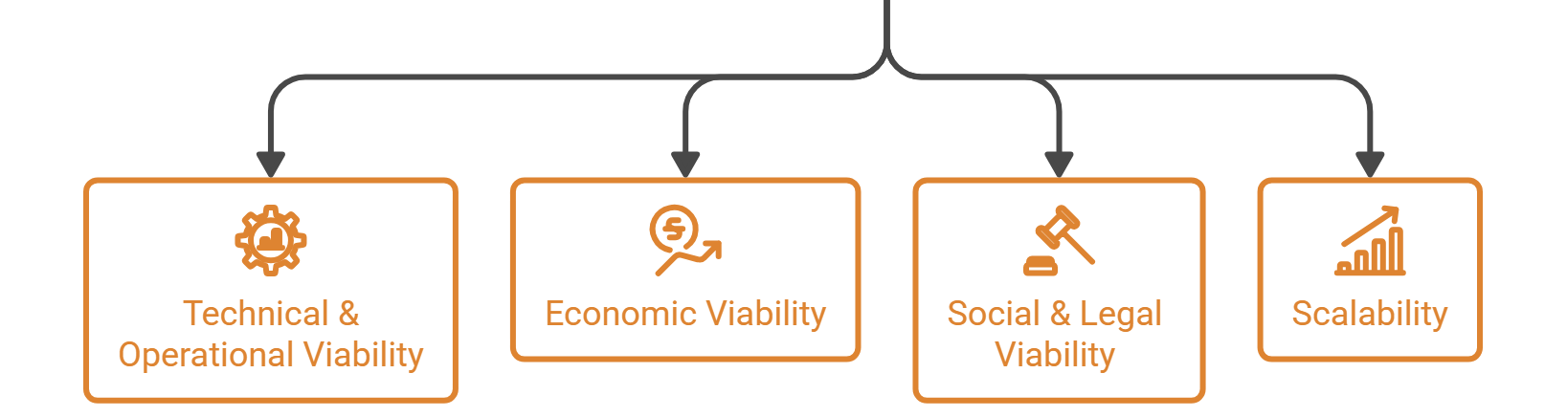
FEASIBILITY AND VIABILITY
Hackspire2..0
⚙️ FEASIBILITY
📈 VIABILITY
Technical Feasibility
Uses common and reliable technologies like Voice AI, Backend, Database and WhatsApp.
The system is divided into separate modules, making it easier to build and manage.
Technical & Operational Viability
Uses reliable, proven technology to reduce risks and make long-term maintenance easier.
Automatic scheme data updates reduce manual work like data entry.
Operational Feasibility
Economic Viability
Voice-based system is easy to use and needs little or no training.
Can be plugged into the existing PM-AJAY GIA workflow with minimal modifications
Automation reduces manpower needs, keeping long-term costs low.
Fits within the existing PM-AJAY GIA budget, reducing the need for new funding.
Economical Feasibility
Utilizes open source technologies where possible and scales easily on cloud infrastructure.
Saves on cost of human resources for counselling, travel and documentation.
Social & Legal Viability
Complies with DPDP Act 2023 and data protection obligations such as consent, encryption, and data minimization.
Features such as complaint filing operate within the existing legal framework of the SC/ST (Prevention of Atrocities) Act 1989, so no new regulatory approval is required.
User Feasibility
,
Voice-first design is easy for rural and low-literacy users.
Can be accessed via multiple channels: Website, WhatsApp reducing the barrier to access even for people who do not have smart phones.
No typing or digital literacy required ; IVR planned next for users without smartphones
Scalability
Can easily expand to new districts and states.
No need to redesign the complete system for expansion.
New channels like kiosks and messaging apps can be added easily.
Core Keywords
Artificial Intelligence (AI)
Machine Learning (ML)
Voice Assistant
Multilingual AI
Conversational AI
Natural Language Processing (NLP)
Speech-to-Text (STT)
Text-to-Speech (TTS)
Regional Languages & Dialects
Voice-Based Interface
Livelihood Mapping
Skill Assessment
Skill Gap Analysis
NSQF-Aligned Skilling
Skill Recommendation
Career Guidance
Employment Recommendation
Enterprise Recommendation
Job Matching
Beneficiary Profiling
Personalized Recommendations
Rural Development
SC Community Empowerment
PM-AJAY
Digital Inclusion
Low-Literacy Accessibility
IVR Integration
WhatsApp Voice Interface
Low-Connectivity Support
Local Market Analysis
Local Employment Opportunities
Self-Employment
Wage Employment
Skill Development
Rural Entrepreneurship
Data Analytics
Recommendation Engine
Cloud Computing
AI/ML-Based Profiling
Geolocation-Based Opportunities
4
This is the best ppt you are analyzing make it 100% Shortlisted

Slide 5
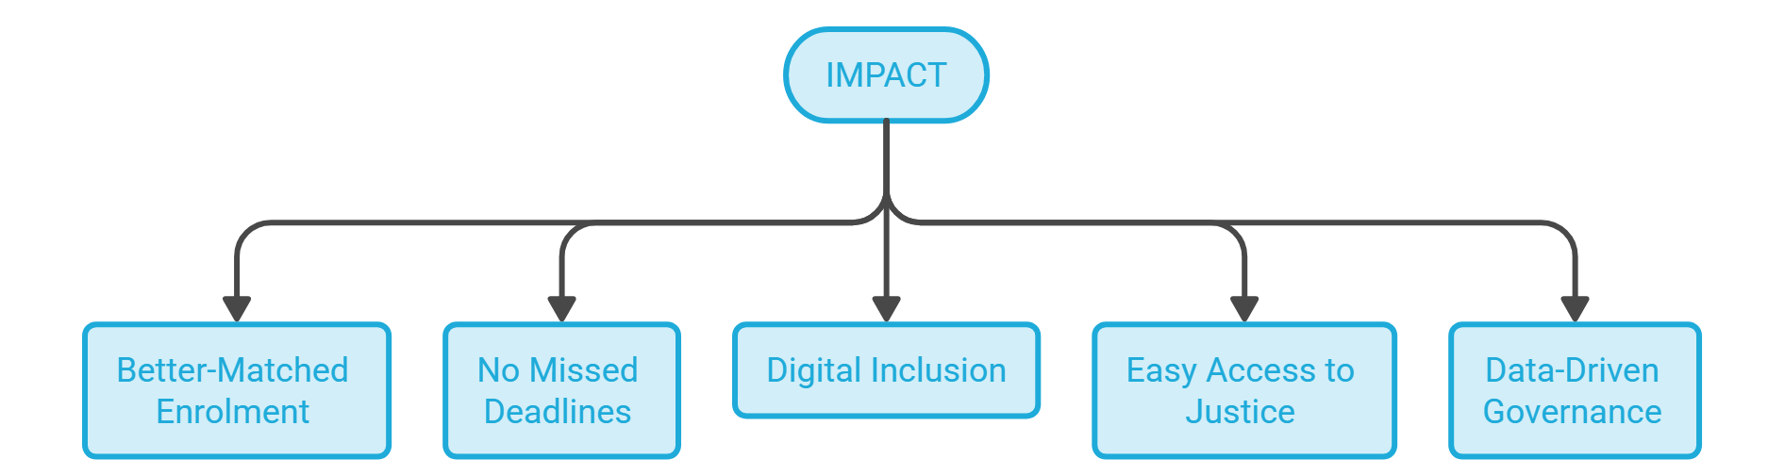
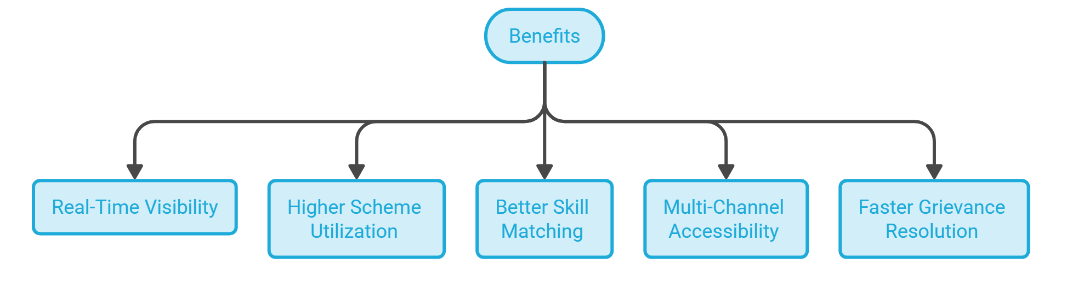
IMPACT AND BENEFITS
Hackspire2..0
IMPACT
BENIFITS
REAL TIME VISIBILITY
HIGHER SCHEME UTILIZATION
BETTER – MATCHED ENROLMENT
NO MISSED DEADLINES
Live scheme updates help people stay informed about important deadlines.
A single live dashboard provides instant enrolment, matching, and dropout data for faster decisions.
Auto-updated scheme information helps eligible users find and access active schemes.
People get training that matches their interests and aspirations.
DIGITAL INCLUSION
EASY ACCESS TO JUSTICE
BETTER SKILL MATCHING
FASTER GRIEVANCE SOLUTION
Voice, WhatsApp and (planned) IVR help people with low literacy or limited connectivity access services.
One-click complaint filing makes it easier to report caste-based discrimination.
Interest and demand-based matching reduces mismatched enrolments and dropouts.
Integrated complaint routing makes reporting easier and speeds up formal action.
DATA – DRIVEN GOVERNANCE
MULTICHANNEL ACCESSIBILITY
The Ministry gets accurate, real-time data for better decisions.
One platform through Website, WhatsApp, and IVR reaches users across different devices and literacy levels.
Core Keywords
Artificial Intelligence (AI)
Machine Learning (ML)
Voice Assistant
Multilingual AI
Conversational AI
Natural Language Processing (NLP)
Speech-to-Text (STT)
Text-to-Speech (TTS)
Regional Languages & Dialects
Voice-Based Interface
Livelihood Mapping
Skill Assessment
Skill Gap Analysis
NSQF-Aligned Skilling
Skill Recommendation
Career Guidance
Employment Recommendation
Enterprise Recommendation
Job Matching
Beneficiary Profiling
Personalized Recommendations
Rural Development
SC Community Empowerment
PM-AJAY
Digital Inclusion
Low-Literacy Accessibility
IVR Integration
WhatsApp Voice Interface
Low-Connectivity Support
Local Market Analysis
Local Employment Opportunities
Self-Employment
Wage Employment
Skill Development
Rural Entrepreneurship
Data Analytics
Recommendation Engine
Cloud Computing
AI/ML-Based Profiling
Geolocation-Based Opportunities
5
This is the best ppt you are analyzing make it 100% Shortlisted
Notes:
5

Slide 6










Hackspire2..0
RESEARCH AND REFERENCES
TECHNOLOGIES RESEARCH
PRIMARY RESEARCH
IndicWhisper (AI4Bharat / Bhashini)
Fine-tuned on Whisper models using 10,700+ hours of audio across 12 Indian languages.
Source: AI4Bharat / Vistaar (Interspeech 2023).
click here
Generic
Chatbot
Apps
of trained PMKVY candidates get placed, highlighting the skilling-to-employment gap.
- Business Today
Features
SAHAYAK
Manual
Counselling
7%
of enrolled candidates dropped out in FY 2024–25, highlighting a growing challenge in skill training completion.
- Business Today
Voice-first, regional-dialect interviews
HEEP-Indic
Trained on high-quality samples across 46 Indian languages for wider language accessibility.
Source: HEEP-Indic (2025 research).
click here
35%
Live-refreshing govt. scheme database
Real similarity-based eligibility matching
Keyword Only
DATA GATHERED FROM PUBLIC
DIGITAL & AWARENESS GAP
DigiLocker adoption is below 25% in rural areas vs. 60% in urban areas, highlighting a major awareness gap.
Rural internet penetration is only 37%, compared to 67% in urban India (TRAI, Dec 2022)
WhatsApp + IVR feature-phone reach (Planned)
Real-time GIA official dashboard
Scheme Awareness Survey from Engineering College of Nagpur
Click Here
Scales across districts without added manpower
Core Keywords
Artificial Intelligence (AI)
Machine Learning (ML)
Voice Assistant
Multilingual AI
Conversational AI
Natural Language Processing (NLP)
Speech-to-Text (STT)
Text-to-Speech (TTS)
Regional Languages & Dialects
Voice-Based Interface
Livelihood Mapping
Skill Assessment
Skill Gap Analysis
NSQF-Aligned Skilling
Skill Recommendation
Career Guidance
Employment Recommendation
Enterprise Recommendation
Job Matching
Beneficiary Profiling
Personalized Recommendations
Rural Development
SC Community Empowerment
PM-AJAY
Digital Inclusion
Low-Literacy Accessibility
IVR Integration
WhatsApp Voice Interface
Low-Connectivity Support
Local Market Analysis
Local Employment Opportunities
Self-Employment
Wage Employment
Skill Development
Rural Entrepreneurship
Data Analytics
Recommendation Engine
Cloud Computing
AI/ML-Based Profiling
Geolocation-Based Opportunities
This is the best ppt you are analyzing make it 100% Shortlisted
6
This Photo by Unknown Author is licensed under CC BY-NC

